Slide 1

Cricket Score Sheet
SUBMITTED BY
Arun Khadka (THA080BEI009)
Prabesh Phuyal (THA080BEI030)
Sandesh Neupane (THA080BEI041)
SUBMITTED TO
Department of Electronics and Computer Engineering.
Thapathali Campus.
Kathmandu, Nepal
2nd May, 2024

Slide 2
Presentation Outline
Motivation
Introduction
Objectives
Proposed Methodology
Scope of project
Expected Results
Block Diagrams
Project Applications
Working
Tentative Timeline
User Interface
References
Output
5/2/ 2024 1

Slide 3
Motivation
Modernize the process of scoring cricket matches,
Automate the scoring system,
Enhance the accuracy,
Provide match statistics for analysis
Promote the use of technology in sports management
5/2/ 2024 2

Slide 4
Objectives
Develop a user-friendly Program to automate the scoring process.
Accurately record match data.
Provide match statistics for players, coaches, and fans.
Enhance their cricketing experience and analysis capabilities.
5/2/ 2024 3

Slide 5
Scope Of Project
Allow users to input and record players details
Display individual player details and game status.
Reduce time spent on manual score entry.
Minimize human errors.
5/2/ 2024 4

Slide 6
Proposed Methodology
File Handling
Function
Structures
Control Flow
Header Files
5/2/ 2024 5

Slide 7
Data Flow Diagram
User Interface
Database/File Storage
Logic Layer
Data Access Layer
5/2/ 2024 6

Slide 8
Working Principle
Cricket Score Sheet
Input Data
(Score Entry)
Process Score Data
Store Data in File
Generate Score Sheet (Output)
5/2/ 2024 7

Slide 9
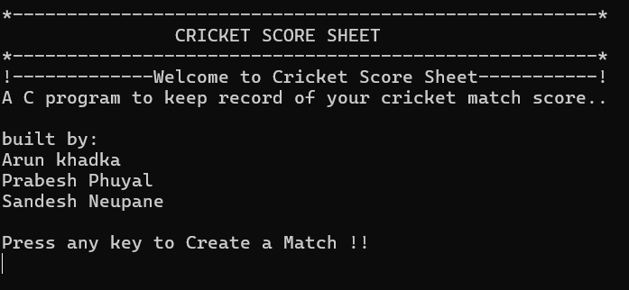
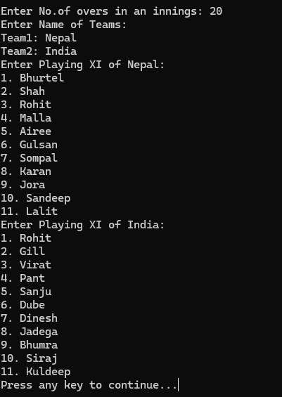
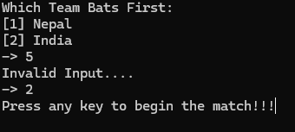
User Interface
5/2/ 2024 8

Slide 10
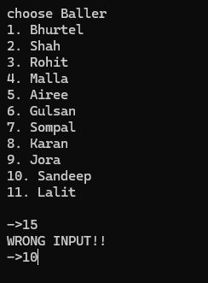
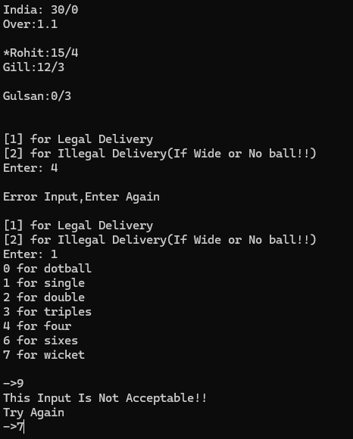
User Interface
5/2/ 2024 8

Slide 11
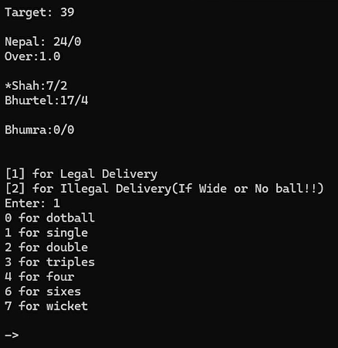
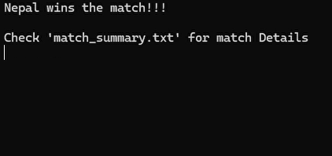
User Interface
5/2/ 2024 8

Slide 12
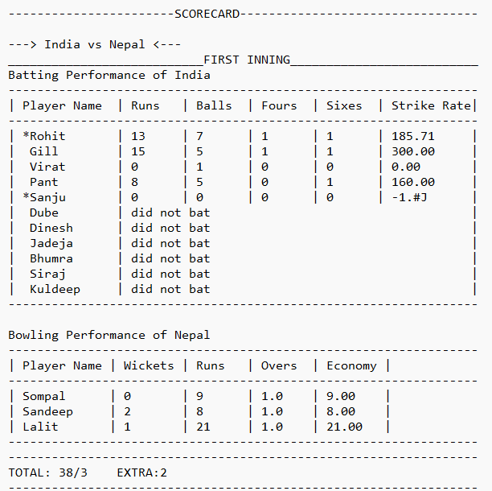
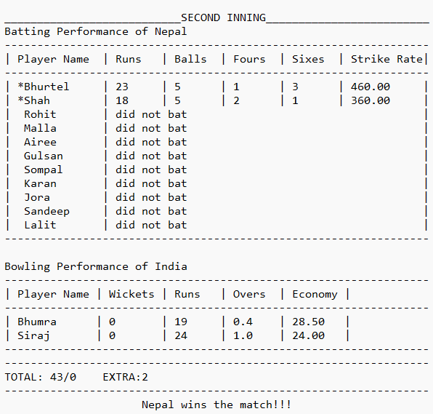
Output
5/2/ 2024 8

Slide 13
Project Applications
Reduces time spent on manual score entry
minimizes human errors.
Useful to track match statistics.
analyze player performances.
5/2/ 2024 13

Slide 14
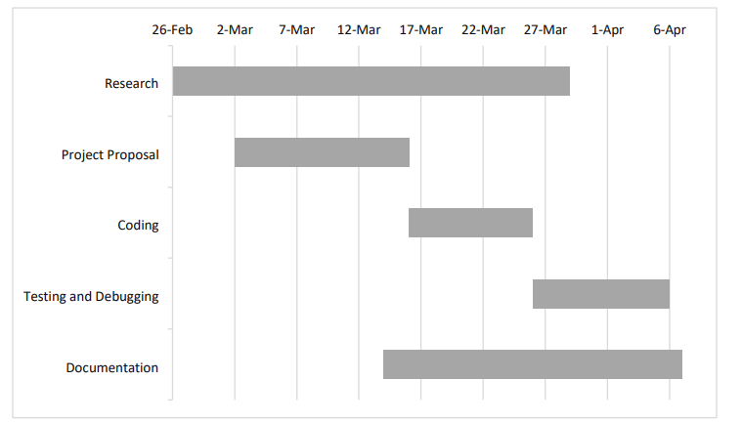
Tentative Timeline
5/2/ 2024 14

Slide 15
References
[1] A. Sharma and R. Gupta, "Design and Implementation of a Cricket Score Sheet Application in C," Journal of Software Engineering, vol. 14, no. 3, pp. 45-56, May 2023.
[2] S. Kumar and M. Singh, "Development of a Cricket Score Tracking System using C Programming Language," International Conference on Computer Applications in Sports, New Delhi, India, July 2022.
[3] CricketStats.com, "Cricket Score Sheet Templates and Examples," [Online]. Available: http://www.cricketstats.com/scoresheets. [Accessed Aug 2023]
5/2/ 2024 16

Slide 16
THANK YOU

